Slide 1

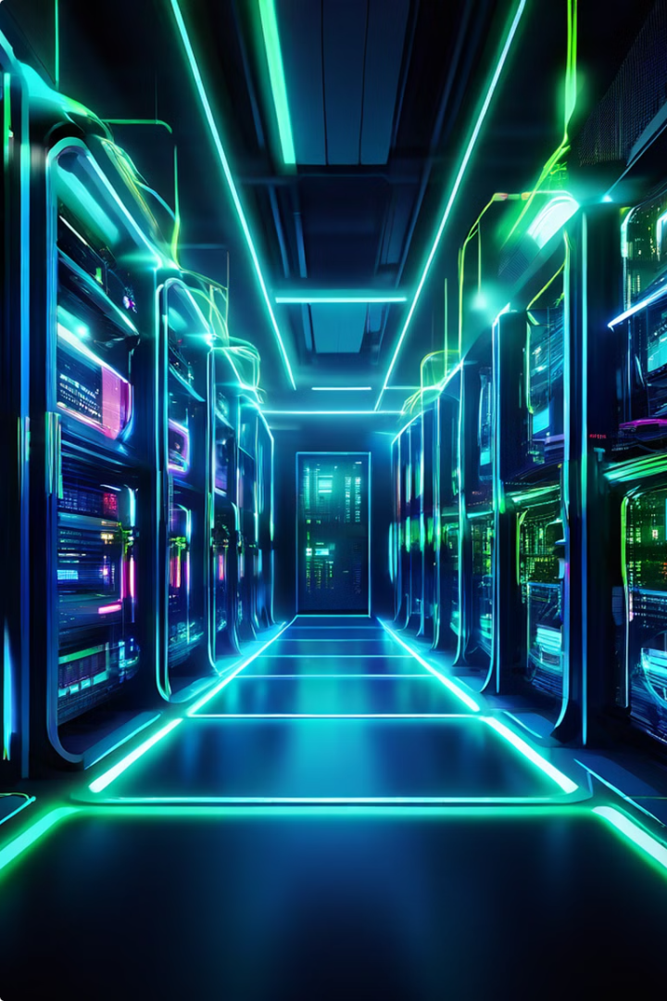

Cloud-Native Computing: The Future of AI
Cloud-native computing is a modern approach to building and deploying applications. It leverages cloud computing principles and technologies, such as containerization and microservices, to create flexible, scalable, and resilient applications.
mu
by muhammad umair

Slide 2
Cloud vs. Edge Computing in AI
Cloud Computing
Edge Computing
Cloud computing involves processing data in centralized data centers.
Edge computing processes data closer to the source, on devices like smartphones or IoT sensors.
Suitable for tasks requiring high computational power or large datasets.
Ideal for real-time applications with low latency requirements.

Slide 3
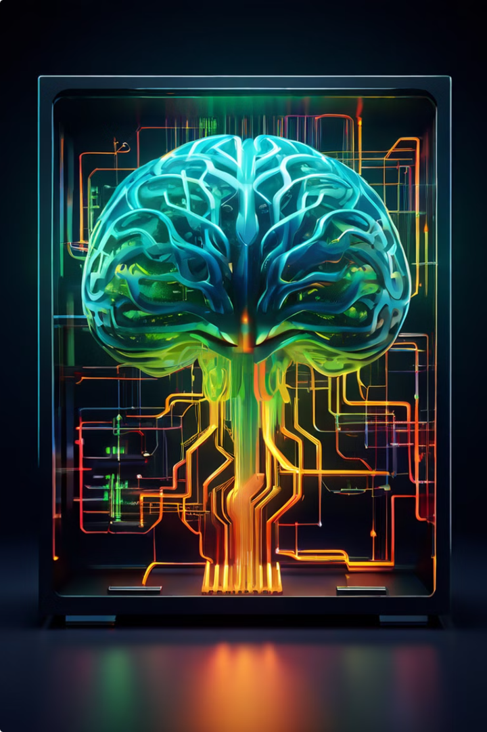
Suitability for AI Applications
1
Cloud Computing
2
Edge Computing
Edge computing is ideal for tasks like image recognition, requiring low latency and real-time processing.
Cloud computing is suitable for tasks like model training, which require vast computing power and data storage.
3
Combined Approach
A hybrid approach, combining cloud and edge, is often the most effective solution for many AI applications.

Slide 4

Advantages of Cloud Computing for AI
Scalability
Cost-Effectiveness
Resource Availability
Cloud platforms provide on-demand access to resources, enabling AI applications to scale up or down based on needs.
Cloud services offer pay-as-you-go pricing models, eliminating the need for upfront investments in hardware.
Cloud providers offer a wide range of AI-specific tools and services, simplifying development and deployment.

Slide 5

Advantages of Edge Computing for AI
Low Latency
Data Privacy
Improved Reliability
Edge computing reduces latency by processing data closer to the source, critical for real-time applications like autonomous vehicles.
Edge computing keeps data local, enhancing privacy and reducing reliance on centralized servers.
Edge devices can operate independently, providing resilience in case of network outages or cloud service disruptions.

Slide 6





Effective Utilization of Cloud and Edge Together
Data Collection
Model Training
Model Deployment
Continuous Learning
Edge devices collect data from sensors or devices, sending it to the cloud for processing.
The cloud's powerful resources are used to train AI models on large datasets.
Trained models are deployed back to edge devices, enabling real-time inference and decision-making.
Edge devices send data back to the cloud for continuous learning and model updates, improving accuracy and performance over time.

Slide 7

Challenges in Integrating Cloud and Edge for AI
Data Security
Ensuring secure data transfer and storage between edge devices and the cloud.
Resource Management
Optimizing resource allocation and communication between cloud and edge resources.
Deployment Complexity
Managing the complexity of deploying and maintaining distributed AI systems across cloud and edge.

Slide 8
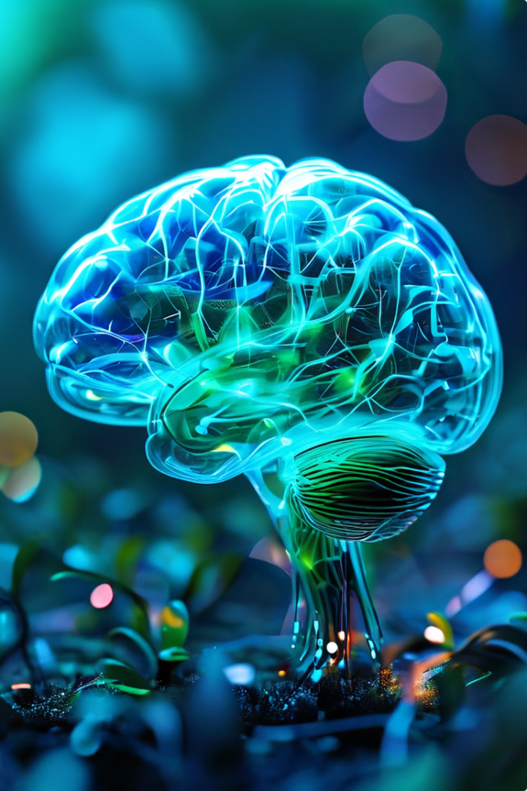
Conclusion and Key Takeaways
Cloud and edge computing offer complementary strengths for AI applications. By leveraging the power of the cloud for training and the agility of the edge for real-time processing, organizations can achieve optimal performance and efficiency. While challenges remain in integrating these technologies, the potential benefits for AI innovation are significant.

